Slide 1
LTTA ACTIVITY
Knowing the target group: Working with
personas

Slide 2
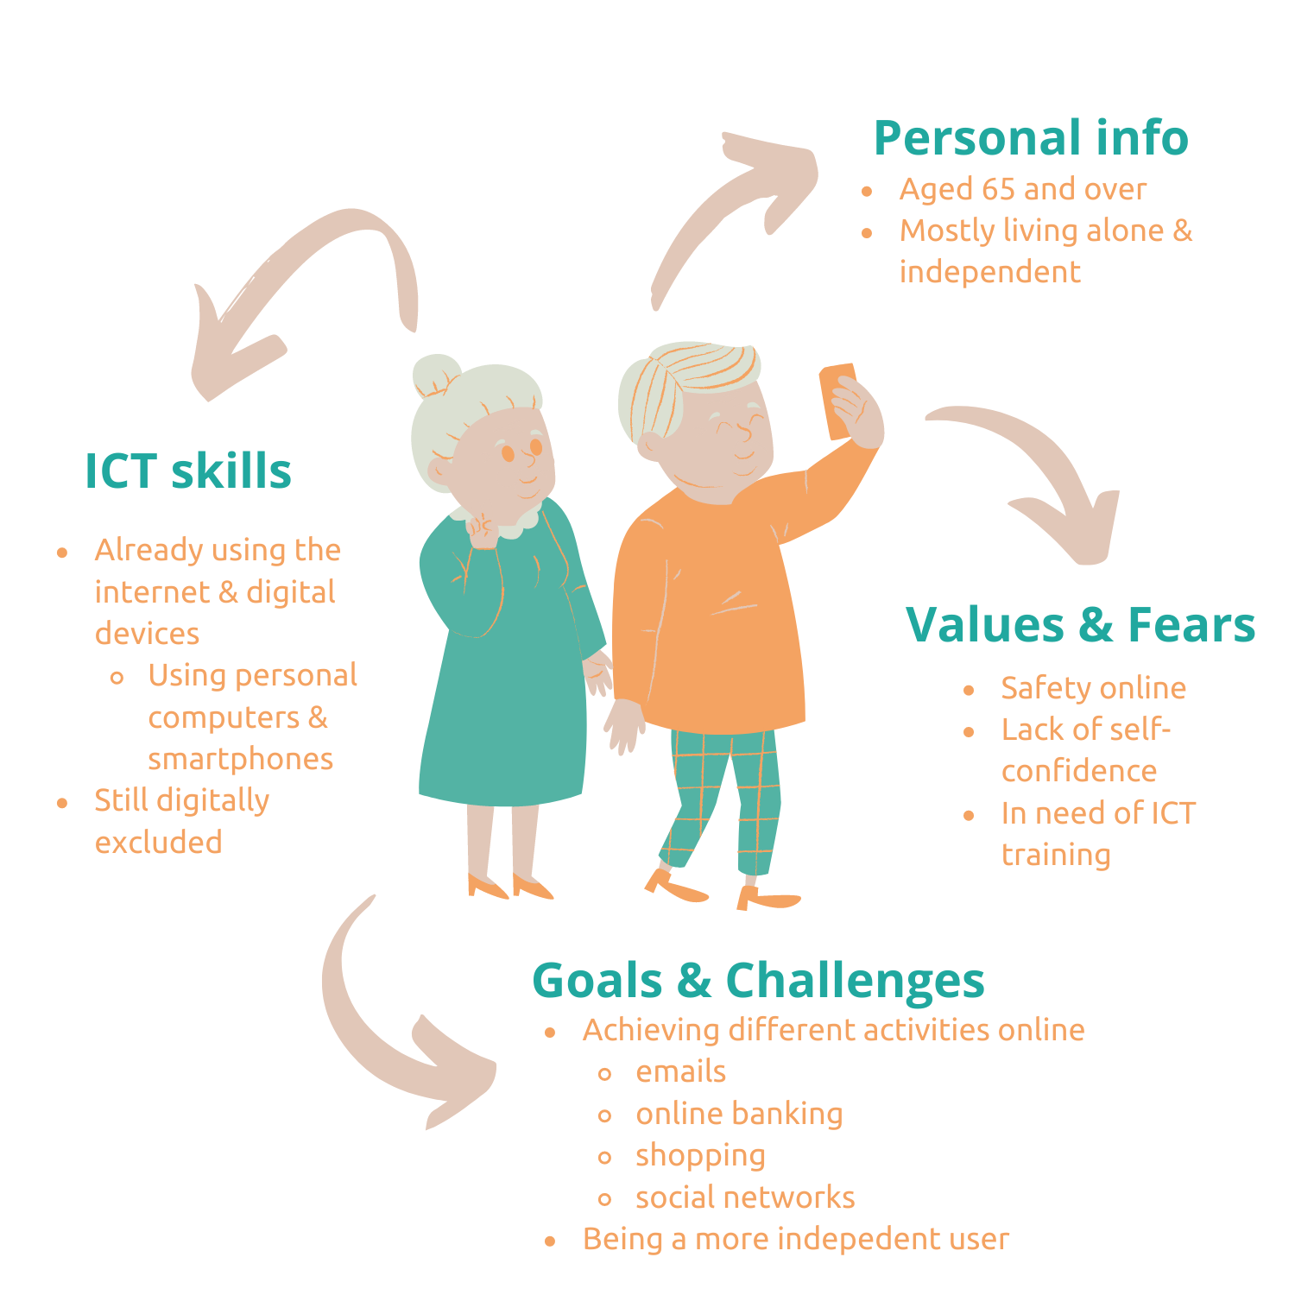
The e-Protect target persona
A target audience persona is a profile of someone who represents a key member of one of your target audience groups.
It’s whom your organization’s strategy is focused toward. Often confused with target audience, your target persona goes beyond demographics and psychographics and focuses more on your prospects’ and audience’s needs and process. When you understand their process and speak to their needs, you can engage with them better.

Slide 3
Diversity among the target group
Things to keep in mind
⚠ There is great diversity in the target group: age, ethnicity, education, computer literacy, cognitive and physical capacity and income. You will need to acknowledge this diversity and learn to know the specific needs of the trainees to provide an effective and long-lasting training.
⚠ Keep in mind national differences between countries in terms of habits, computer literacy, etc.
⚠ Take into consideration the common health problems (e.g. impaired vision/hearing) that the trainees may have.
⚠ Lack of motivation, interest and perceived lack of relevance of digital technology to their needs and preferences is the main issue you could face. You need to find ways to make the trainees see what their interest is in developing digital literacy.

Slide 4
Activity
Build your own Target Persona!
Knowing your own audience, what are the characteristics you attribute to the adults in your organizations? Let’s compare our personas to get a better understanding of our target groups!
Notes:
Steps to create your own persona:
A Name
This helps you identify the persona, especially if you are creating more than one. This makes it easier for you and your marketing team to plan and create ads because you already have a visual image of a person based on his name. If you simply give your persona a code or a number as an identifier, you will likely not think of him as a person, making it harder to dive into the marketing psychology for this target.
To create a name, you can simply take the first name of a previous customer, or you can look into people under the demographics of your target audience. You can also name your persona arbitrarily, as long as you can differentiate him from the rest of the personas you create.
Demographic details
This includes the age (can be the median age if coming from an age range), financial status, marital status, family system (descriptions such as single child, divorced parents, has three kids, etc.), career path (businessman, lawyer, engineer, secretary, etc.)
Interests
Since we consider the target persona as an actual person, he or she must have interests, hobbies, and other matters that captivates his attention and takes up his time. It is important to take note of this, even if you think these interests are not related to the product or service you are trying to promote.
Behavioral traits
These are certain actions and reactions that your target audience undergo when faced with specific circumstances. These are behaviors that can help you predict and influence what your audience will do next when faced with a situation. This includes their business decisions and buying behaviors.
Goals and motivations
This includes both short and long term goals. What do they intend to achieve in this lifetime? Does he or she hope to build a home, buy a vehicle, a boat, or a second house? What are his dreams? Does he hope to get promoted in his job?
Pain Points
What are your customers’ issues? What problems do they encounter on a day to day basis? What are their long-term concerns? Your audiences’ pain points are what drives them to either avoid or indulge in certain things. These are very useful in finding the right angle when trying to attract your audience.
Day to Day Activities and Sources of Information
This is actually not a requirement, but is a good way to help you grasp how your target customer thinks and reacts. It also help you evaluate their routine, therefore, allowing you to determine the best way to interrupt in a positive manner.
A Face
To make your buyer persona more realistic, you could give them a face using stock photography. You could also create cardboard cutouts of your target persona to give them a real presence within your office.
The whole point is to address this model customer as a real person to allow you to craft marketing messages directed specifically to them, and guide everything starting from product development, to the voice of your brand, to the advertising channels you use.

Slide 5
Activity
Steps to build a persona
Give it a name: This helps you identify the persona, especially if you are creating more than one.
Include demographic details: Include the age range, living situation, career path, etc.
List their Interests: Since we consider the target persona as an actual person, they must have interests, hobbies, and other matters that captivates his attention and takes up his time. Take them into consideration even if you think they are not related to the interests of your organization.
Identify their behavioural traits: These are certain actions and reactions that your target audience undergo when faced with specific circumstances.
Understand their goals and motivations: This includes both short and long term goals.
Identify their points of issue: What are your customers’ issues? What problems do they encounter on a day to day basis? What are their long-term concerns?
Know their day to day activities and sources of information: This is actually not a requirement, but is a good way to help you grasp how your target customer thinks and reacts.
Add a face: The whole point is to address this model customer as a real person, it can help you make it more realistic.

Slide 6
THANK YOU!

