Slide 1
Digital Skills for Consumer and Data Protection during internet use for the elderly
LTTA – 22-25/05/2022 – Athens, Greece

Slide 2
Digital Skills
Why are they important?
Digital Transformation…
Technological changes and developments:
Blockchain,
5G,
Artificial Intelligence,
IoT and IoB,
VR/AR/MR,
Cybersecurity,
Human augmentation etc.
Government and private services are being digitally transferred (e.g. banks, healthcare system, markets)
New forms of education and work (e.g. distance learning courses and programmes, teleworking)
Global networking, communication, and collaboration in the business world
Socialisation
And more...

Slide 3
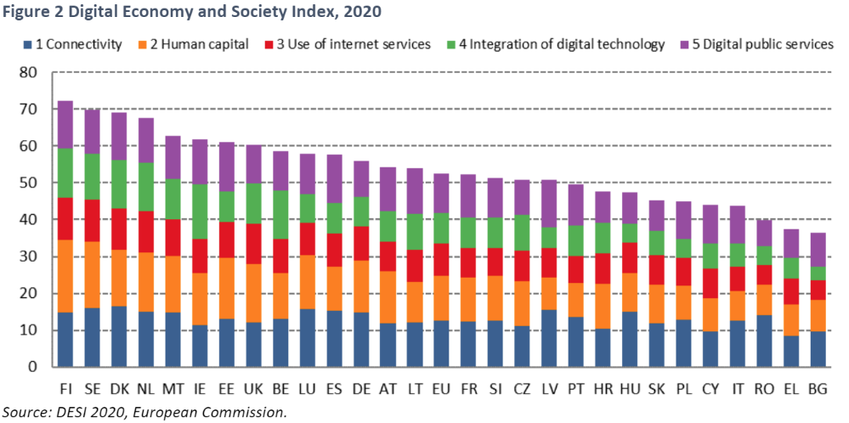
Europe’s digital performance
DESI - Digital Economy and Society Index (source: European Commission, 2020)

Slide 4
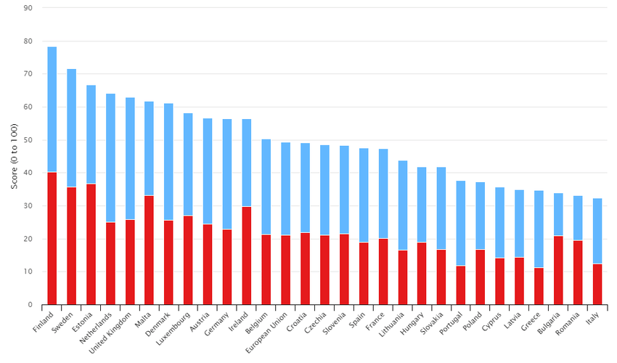
Europe’s digital performance
DESI - Digital Economy and Society Index (source: European Commission, 2020)
2. Human capital
Red: Internet user skills
Blue: Advanced skills and Development
Notes:
Indicator: 2 Human Capital
Definition: DESI Human Capital Dimension calculated as the weighted average of the two sub-dimensions: 2a Internet User Skills (50%) and 2b Advanced Skills and Development (50%)
Breakdown: 2a Internet User Skills
Breakdown: 2b Advanced Skills and Development

Slide 5
Digital skills
Percentage of adults with at least a basic level of digital skills in EU (2019)

Slide 6
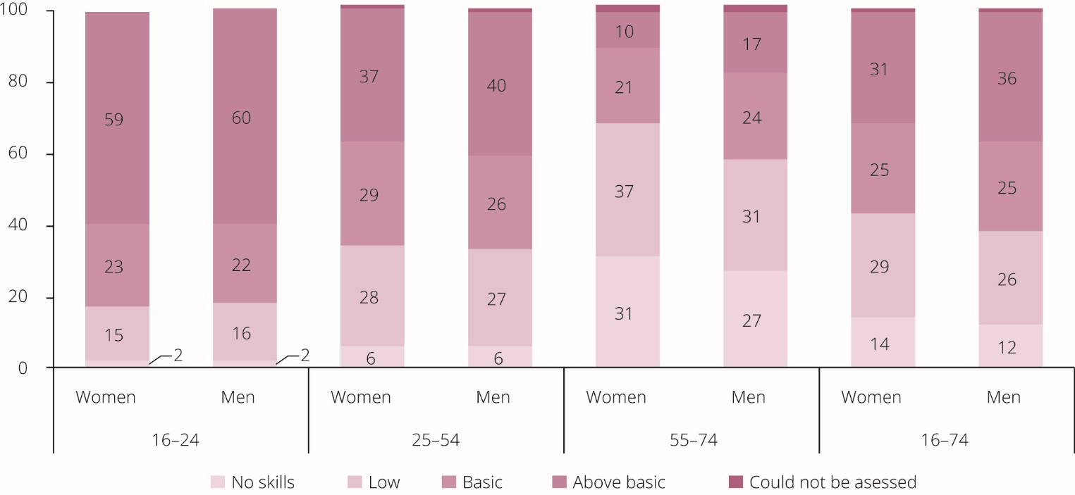
Digital divide
Levels of digital skills of individuals in the EU, by sex and age group (%) (source: Eurostat, 2019)

Slide 7
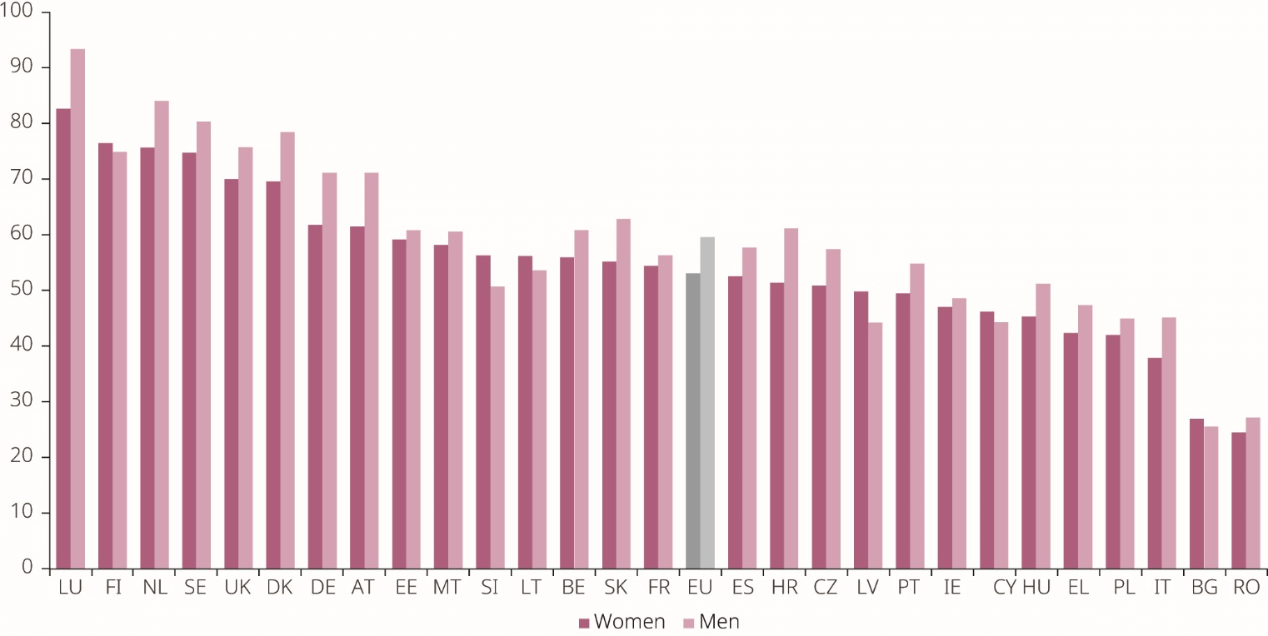
Digital divide
Internet user skill scores by sex (source: European Commission, WiD Scoreboard, 2017)

Slide 8
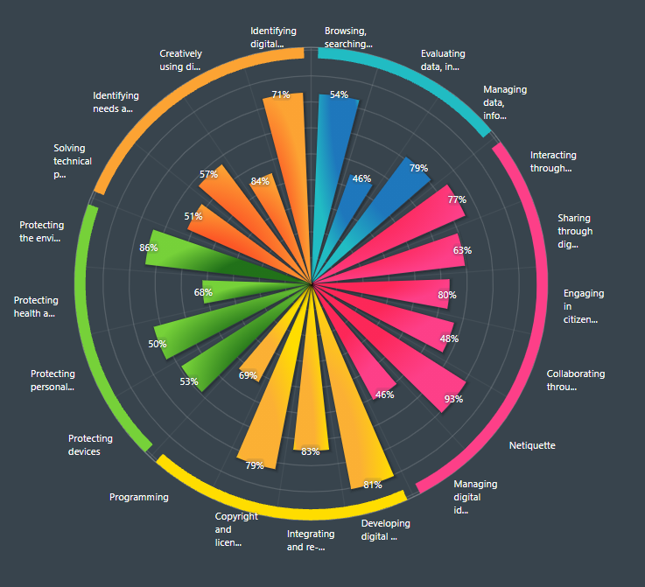
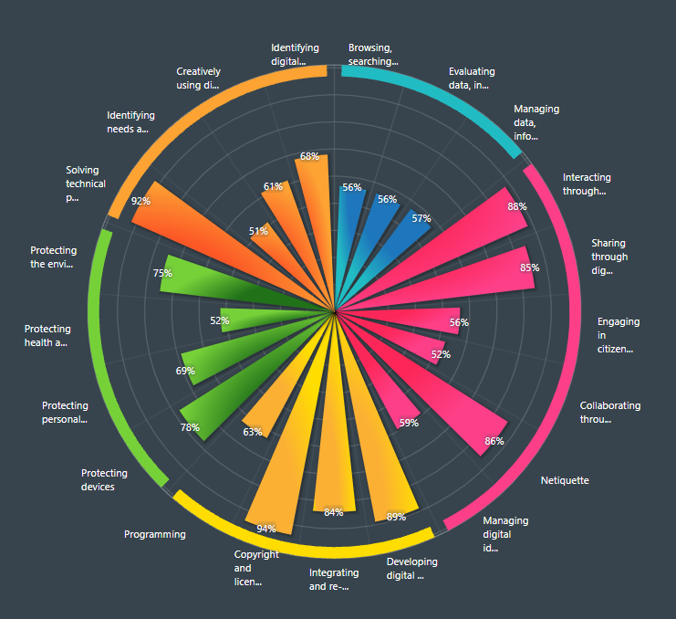
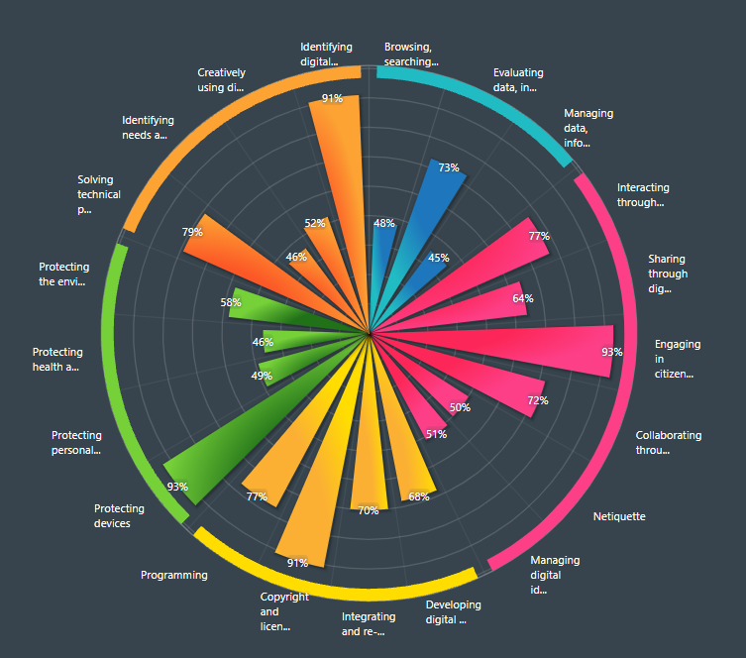
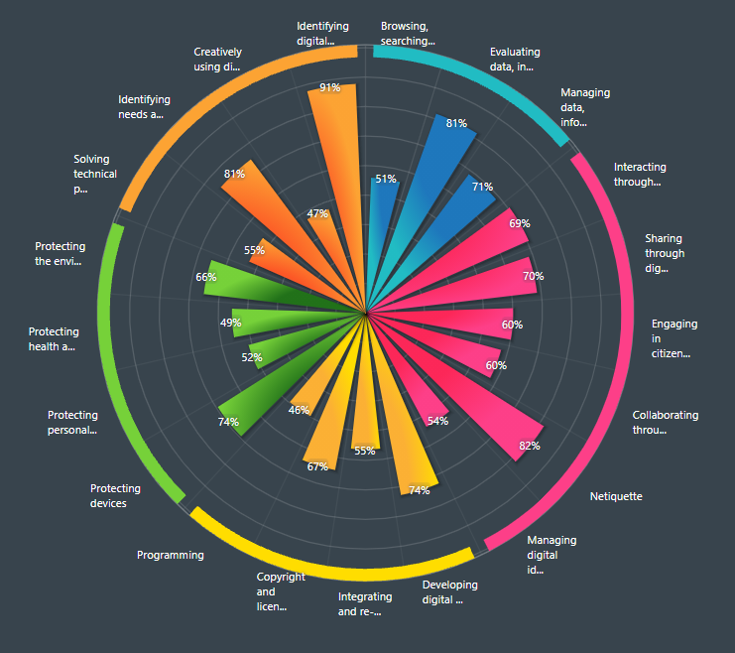
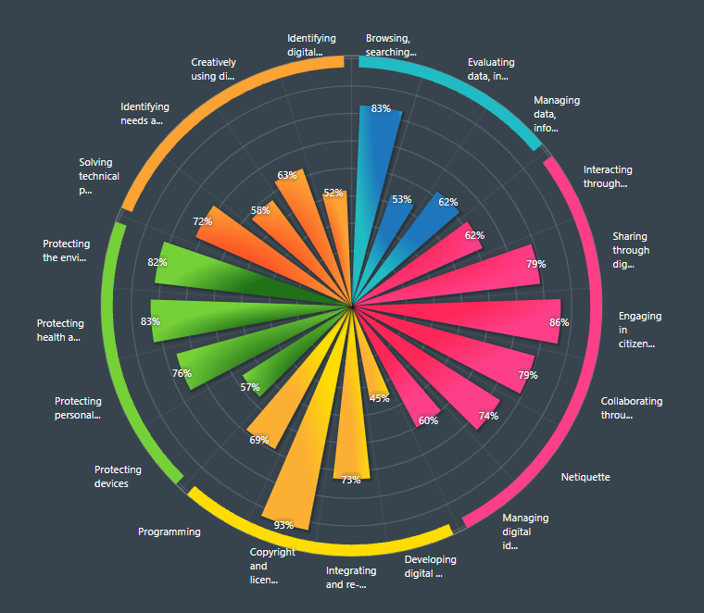
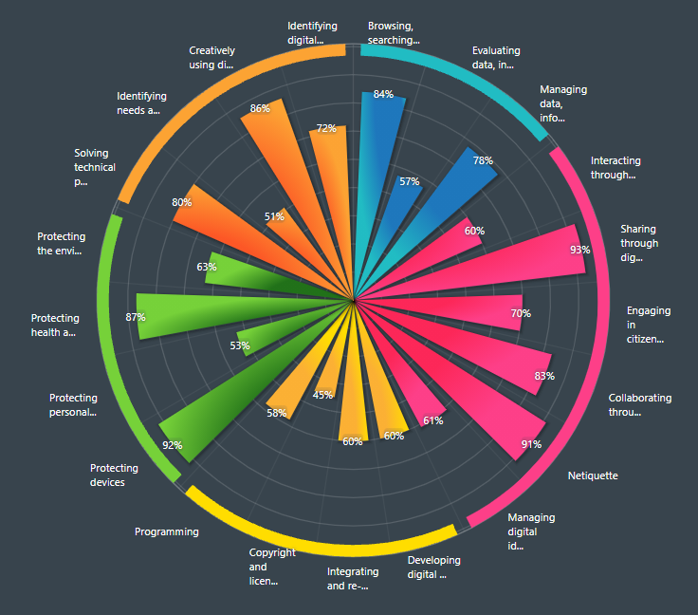
Do you think you have digital skills?

Slide 9
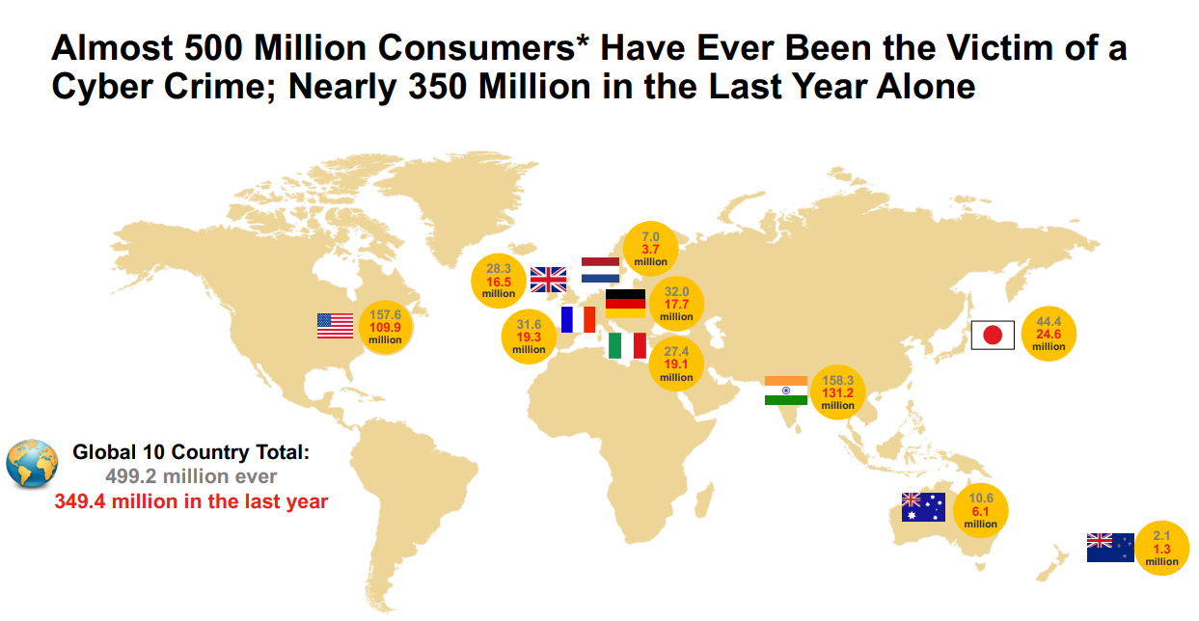
Cyber Crime: Incidence and Impact
The Harris Poll. (2020). 2019 Cyber Safety Insights report: Global Results. Retrieved from https://now.symassets.com/content/dam/norton/campaign/NortonReport/2020/2019_NortonLifeLock_Cyber_Safety_Insights_Report_Global_Results.pdf?promocode=DEFAULTWEB

Slide 10
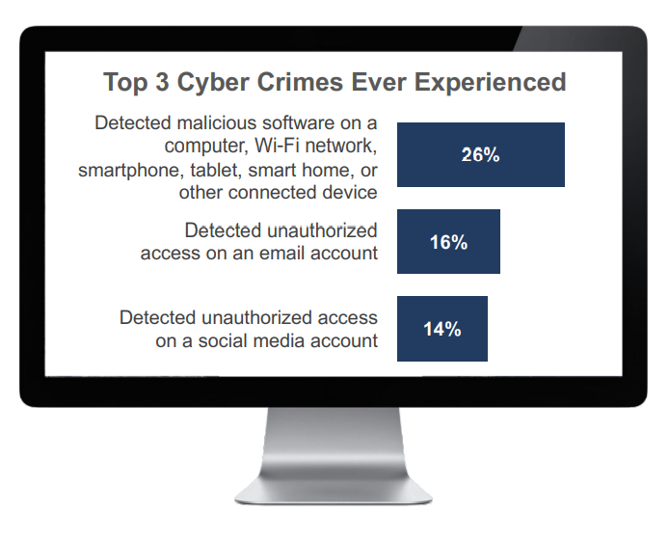
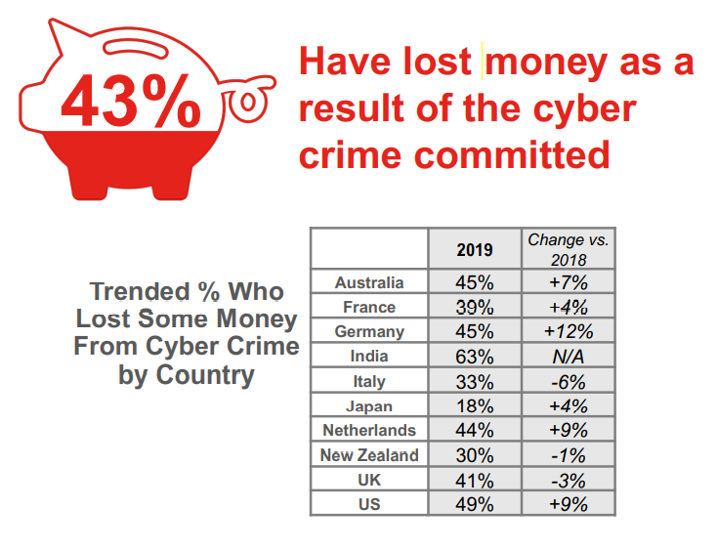
Cyber Crime: Incidence and Impact
More Than 2 in 5 Cyber Crime Victims Were Impacted Financially during the Past Year

Slide 11
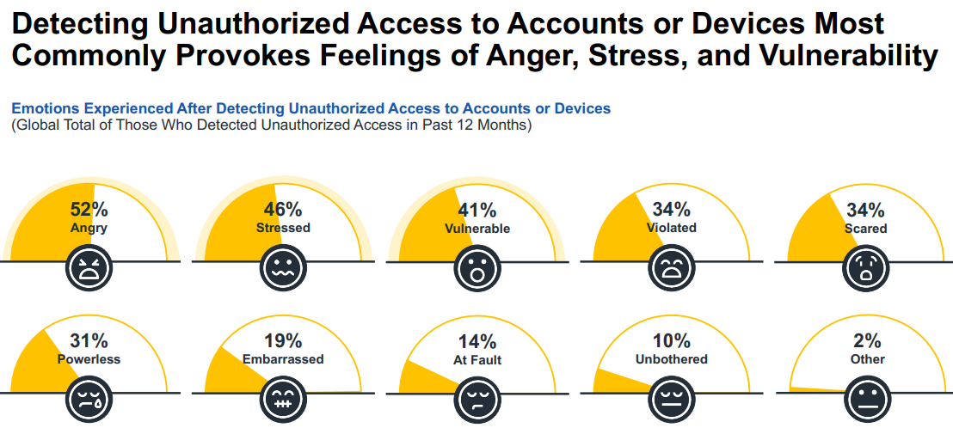
Cyber Crime: Incidence and Impact
The Harris Poll. (2021). 2020 Cyber Safety Insights report: Global Results. Retrieved from https://now.symassets.com/content/dam/norton/campaign/NortonReport/2021/2021_NortonLifeLock_Cyber_Safety_Insights_Report_Global_Results.pdf

Slide 12
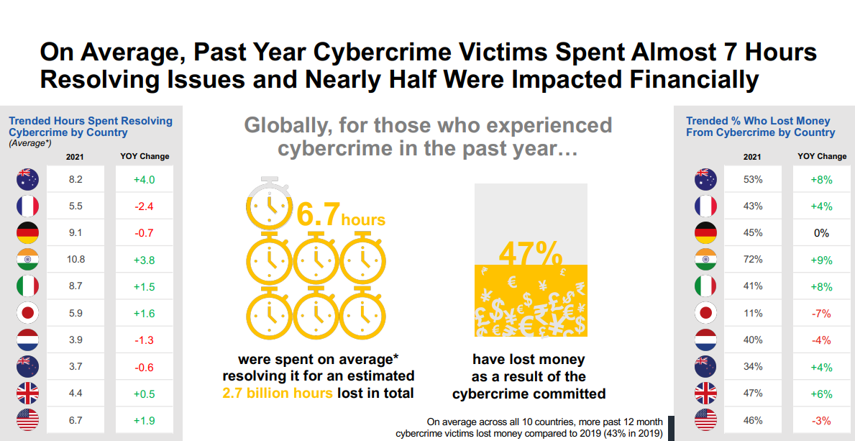
Cyber Crime: Incidence and Impact

Slide 13
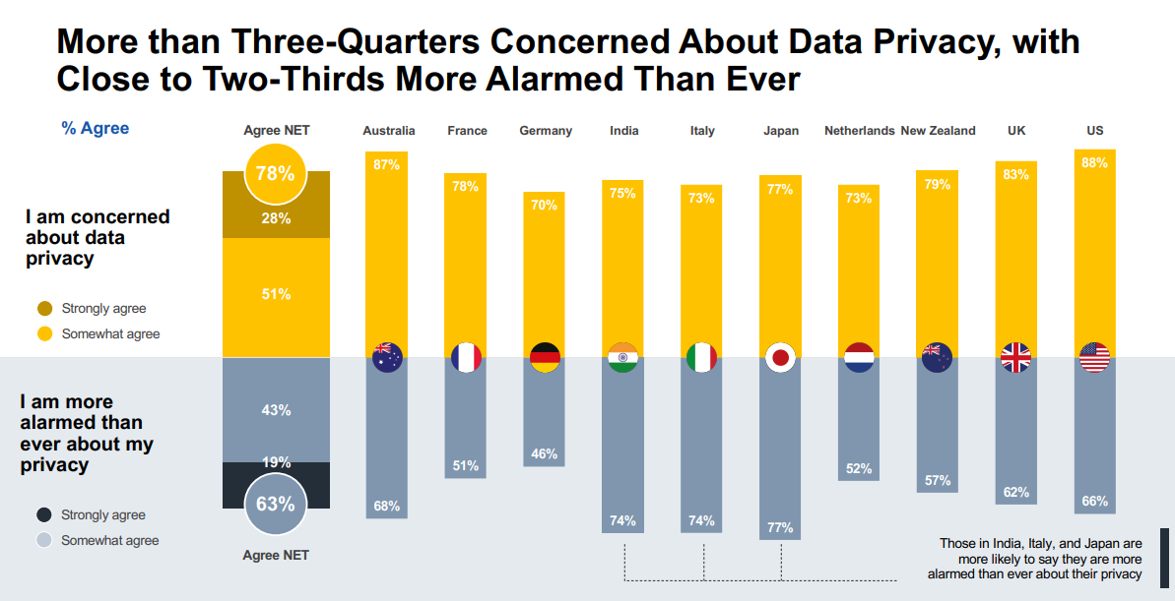
Identity Theft: Incidence & Attitudes

Slide 14
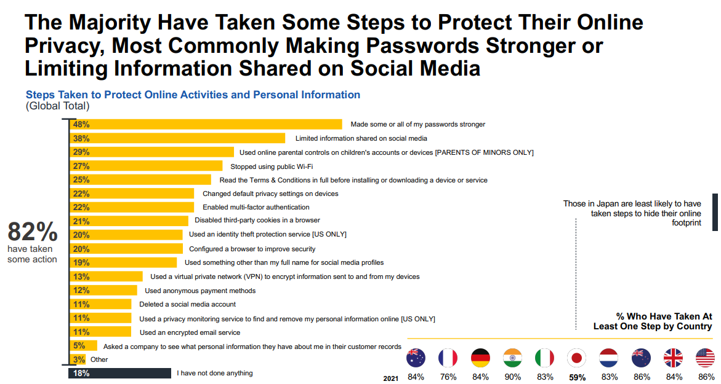
Protecting Personal Privacy

Slide 15
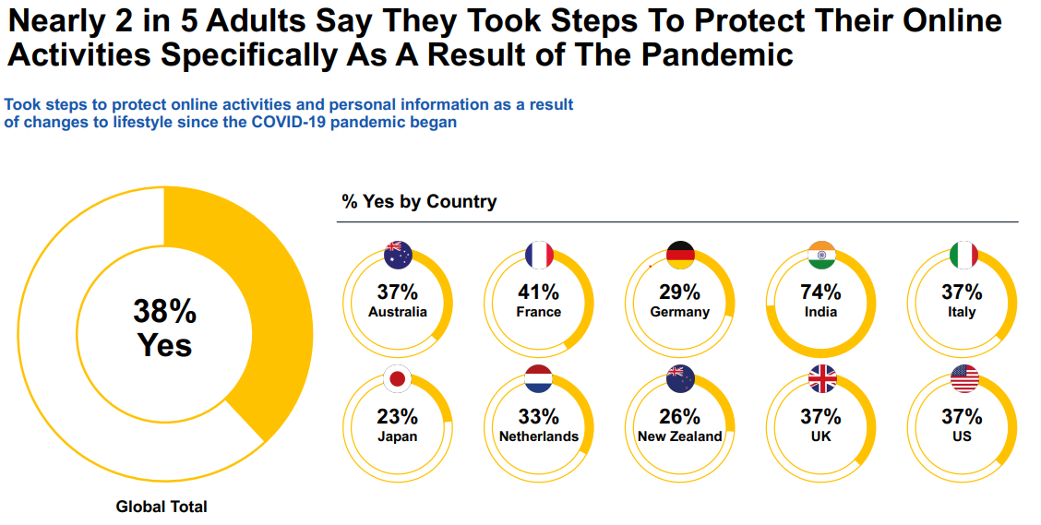
Protecting Personal Privacy

Slide 16
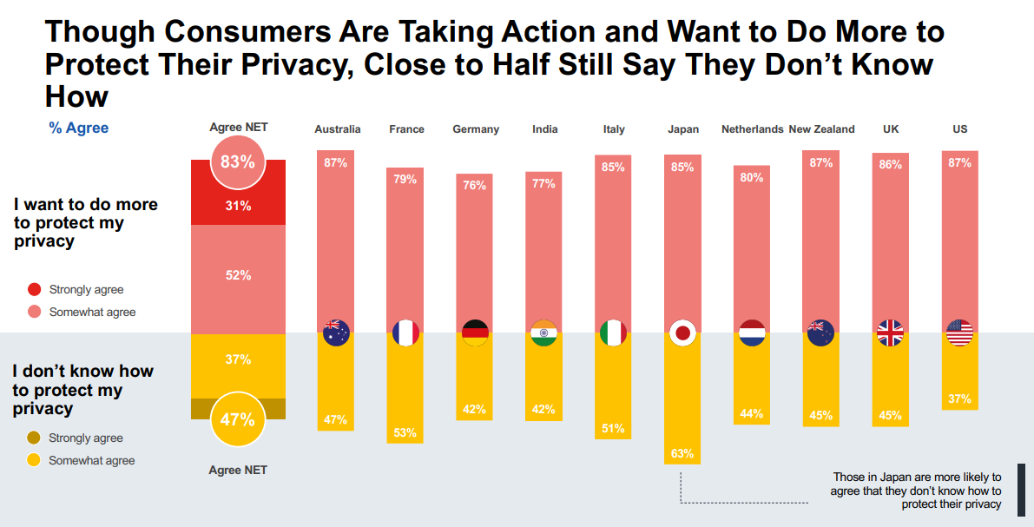
Cyber Crime: Protecting Personal Privacy

Slide 17
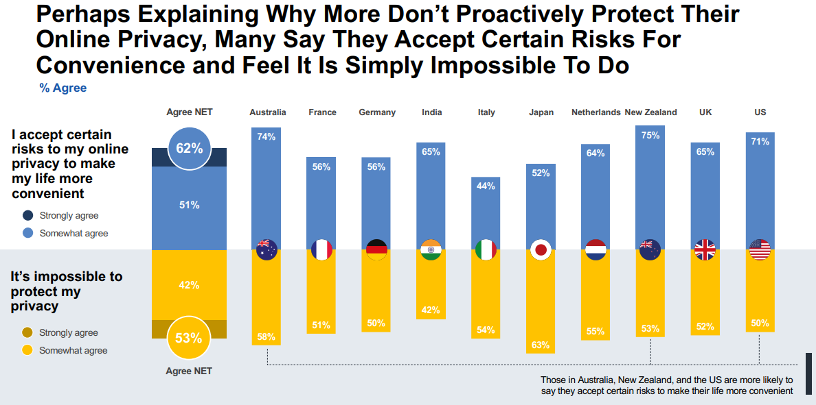
Cyber Crime: Protecting Personal Privacy

Slide 18
E-Protect project
The aim
The project aims to address the consumer and data protection needs during internet use of the elderly people through:
Familiarization with the ICT tools and provision of tailored training
Enhancing the capacity and professionalization of adult educators with training material
Improving the overall quality of adult education for the elderly
Reducing the inequalities in access in education for elderly

Slide 19
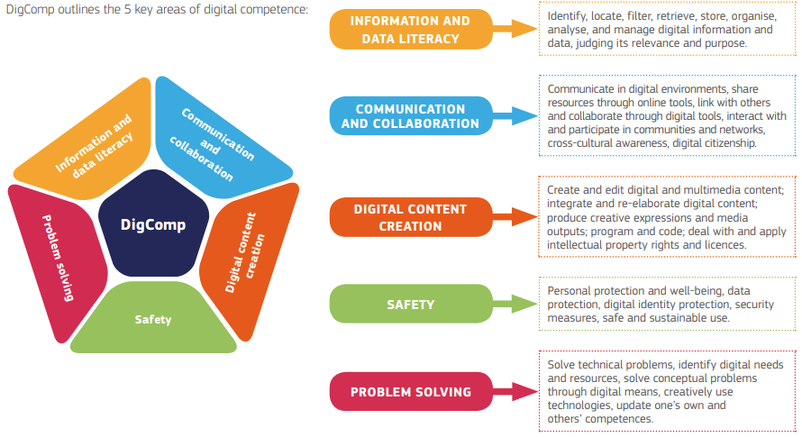
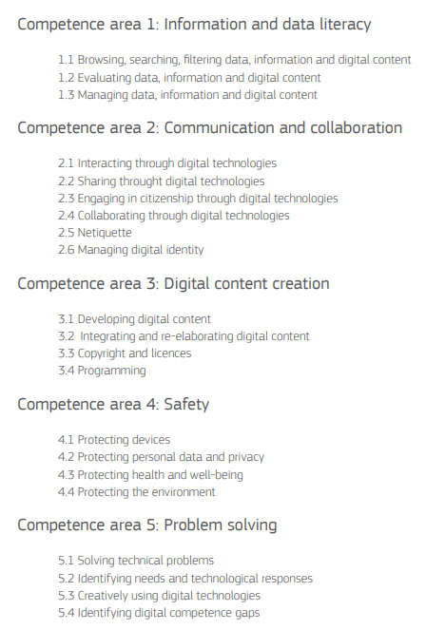
The European Digital Competence Framework 2.1
Example of Competency framework

Slide 20
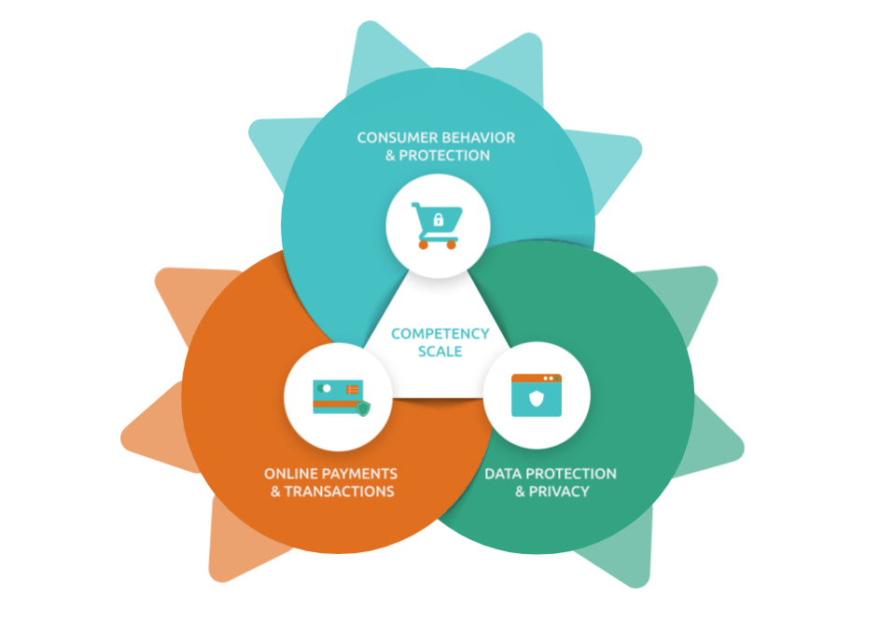
E-Protect Competency Scale
Visit our website:
www.eprotect-project.eu/competency-scale/

Slide 21
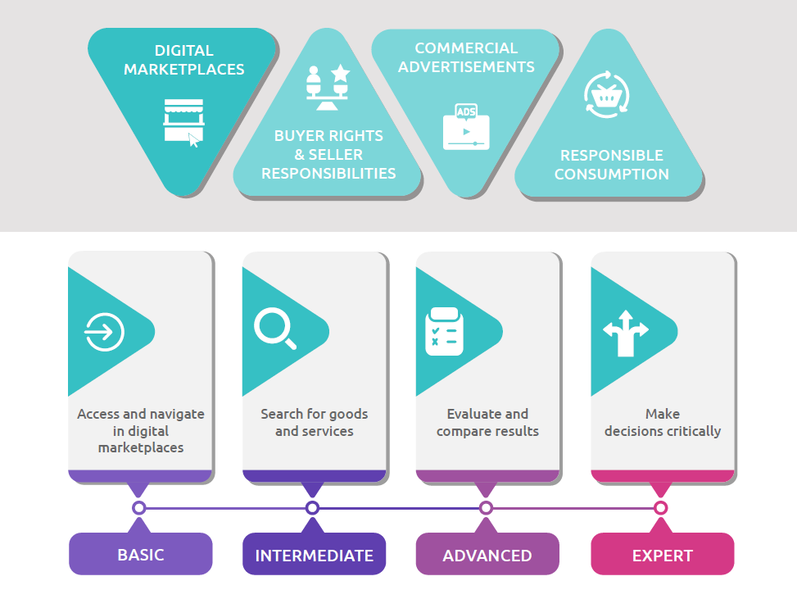
E-Protect Competency Scale
1. CONSUMER BEHAVIOUR & PROTECTION

Slide 22
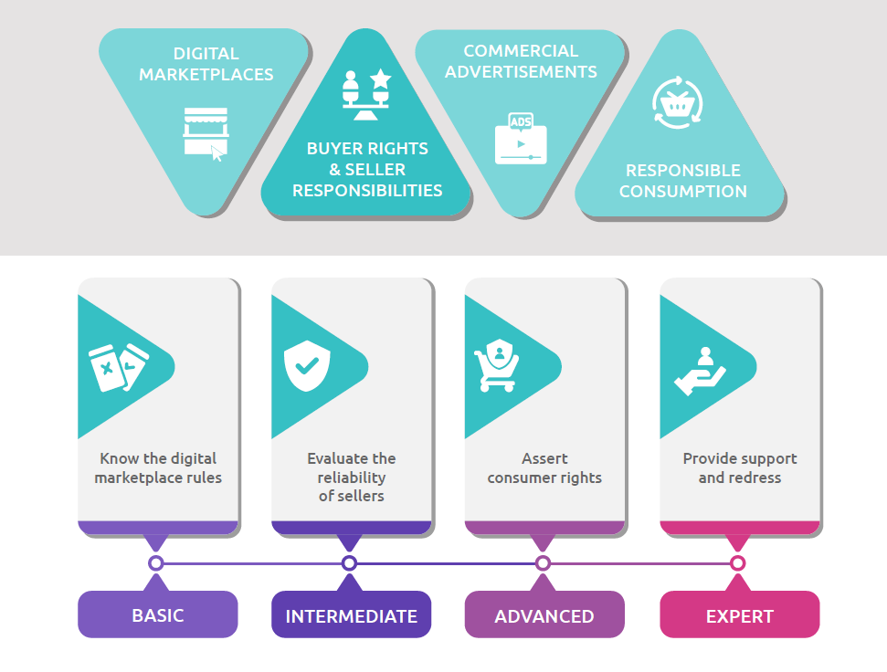
E-Protect Competency Scale
1. CONSUMER BEHAVIOUR & PROTECTION

Slide 23
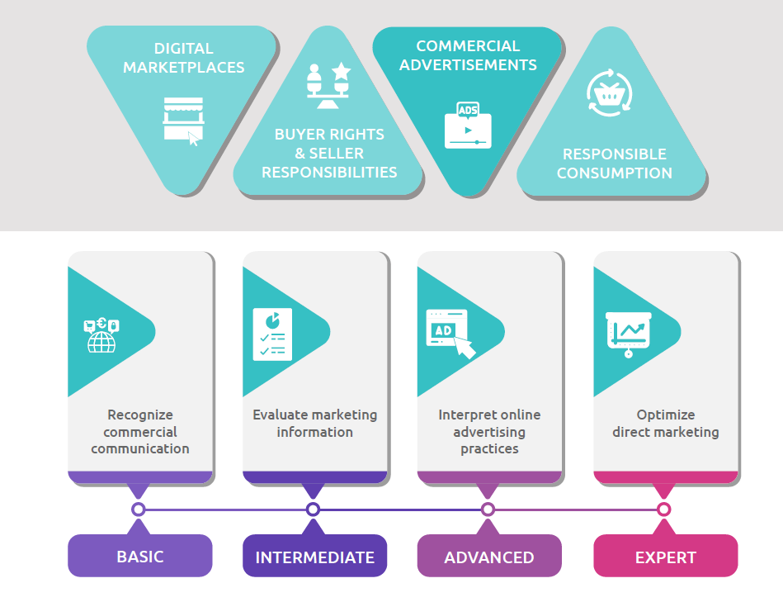
E-Protect Competency Scale
1. CONSUMER BEHAVIOUR & PROTECTION

Slide 24
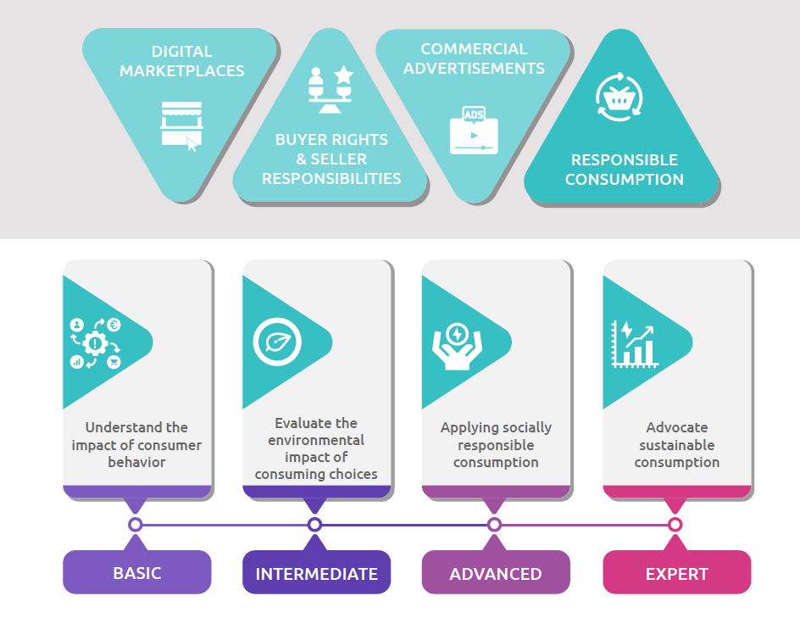
E-Protect Competency Scale
1. CONSUMER BEHAVIOUR & PROTECTION

Slide 25
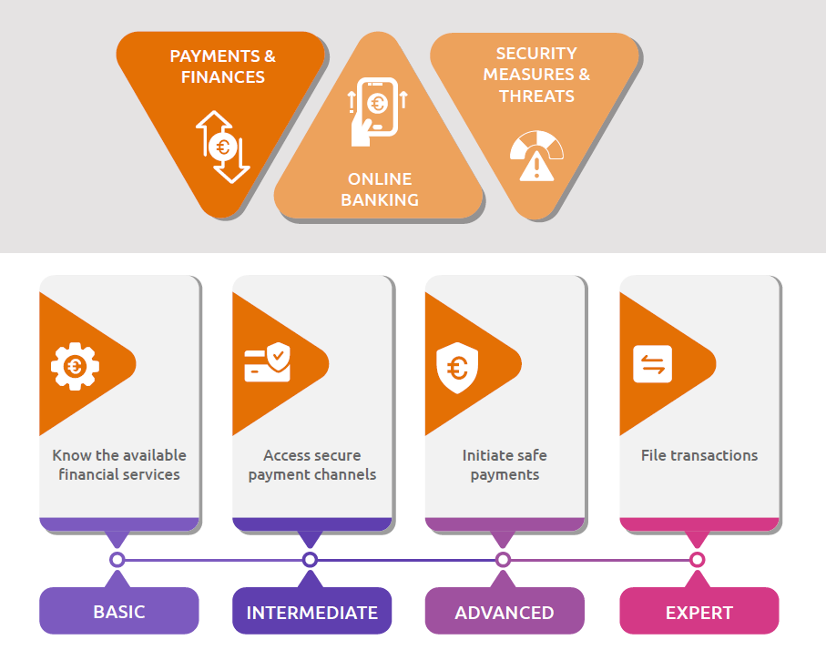
E-Protect Competency Scale
2. ONLINE PAYMENTS & TRANSACTIONS

Slide 26
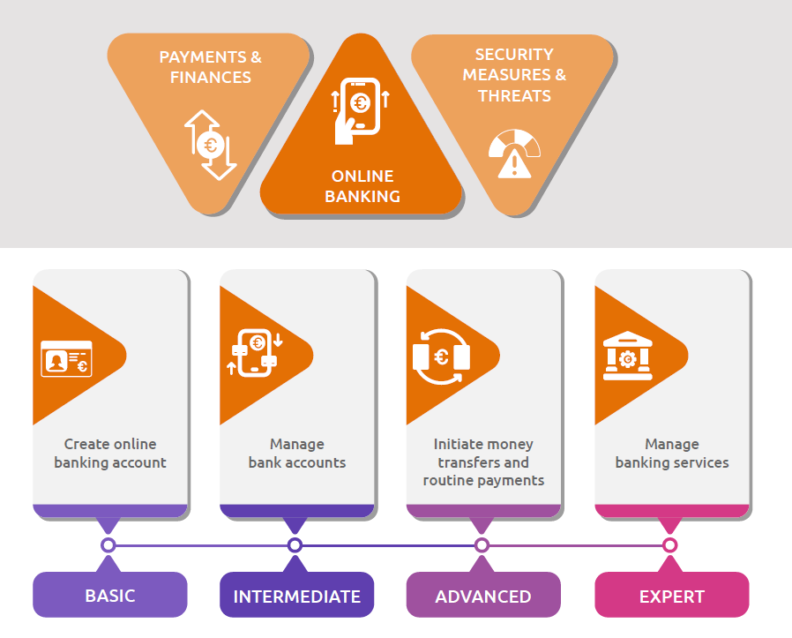
E-Protect Competency Scale
2. ONLINE PAYMENTS & TRANSACTIONS

Slide 27
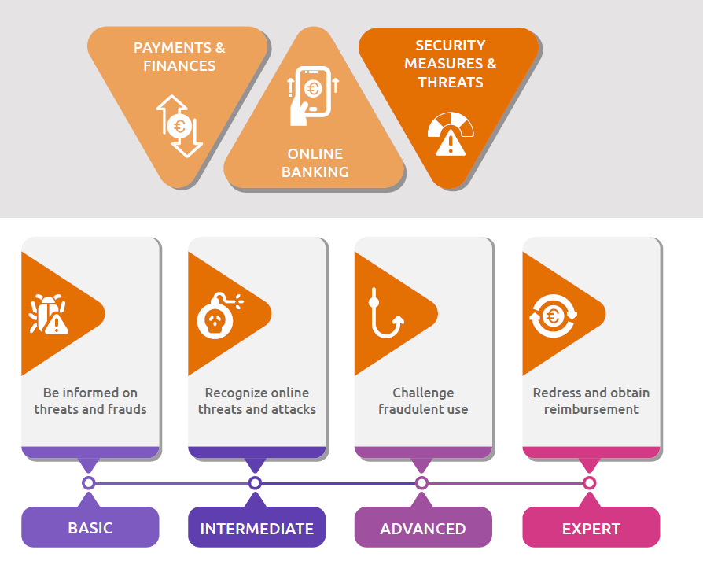
E-Protect Competency Scale
2. ONLINE PAYMENTS & TRANSACTIONS

Slide 28
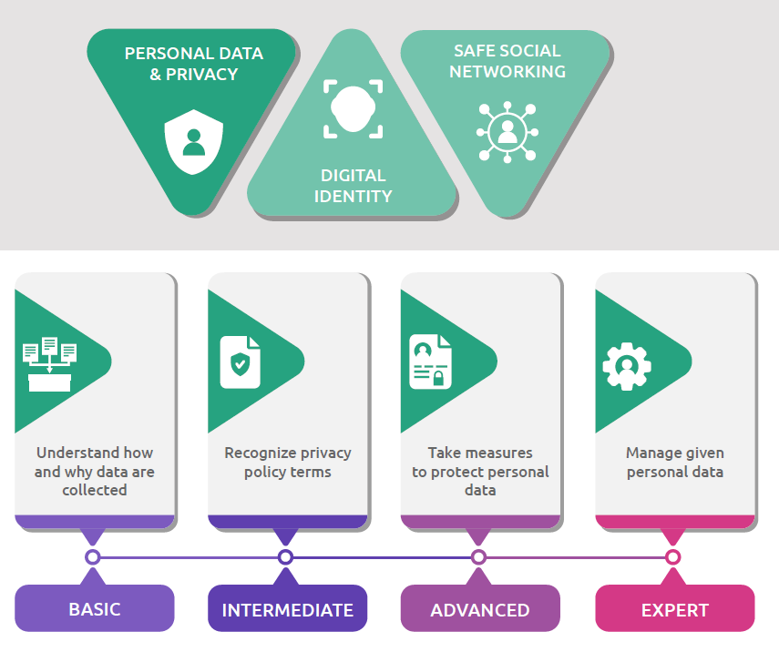
E-Protect Competency Scale
3. DATA PROTECTION & PRIVACY

Slide 29
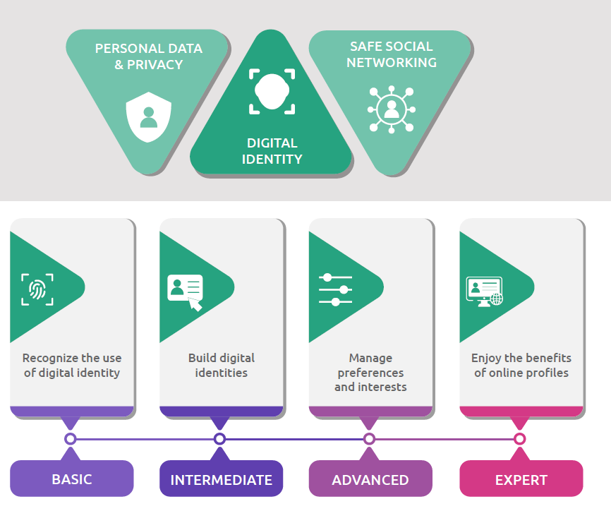
E-Protect Competency Scale
3. DATA PROTECTION & PRIVACY

Slide 30
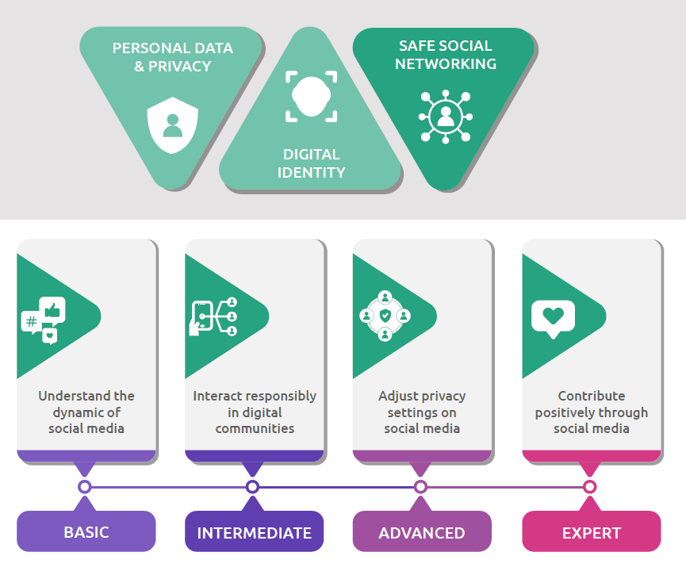
E-Protect Competency Scale
3. DATA PROTECTION & PRIVACY

Slide 35
Emails please
www.menti.com
31 62 96 74

